Slide 1
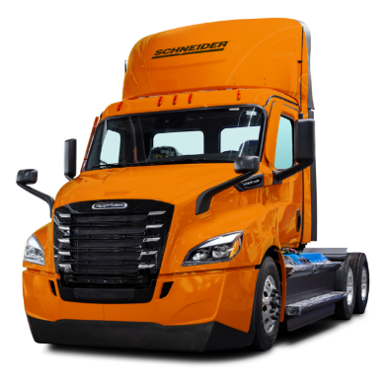
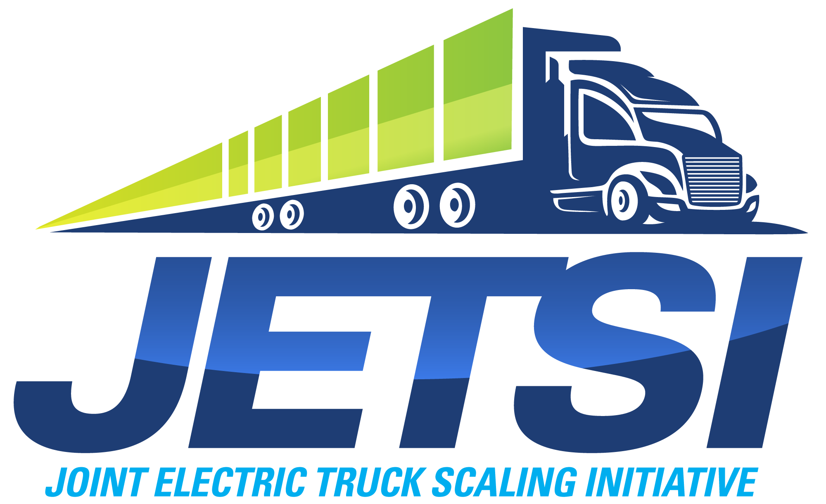
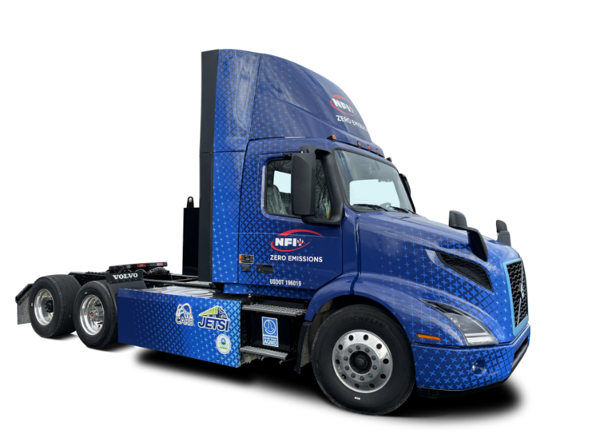
Joint Electric Truck Scaling Initiative (JETSI)
2023 update

Slide 2
Agenda
Introduction
Project Background
Deployment
Project Focus

Slide 3
Project Background
JETSI is the largest deployment of battery-electric trucks in North America to date, significantly increasing the number of zero-emission heavy-duty trucks available for goods movement while achieving necessary emission reductions.

Slide 4
Made Possible by
JETSI is jointly financed by California Air Resources Board and California Energy Commission ($26.98 million), South Coast AQMD ($5.43 million), with an additional $41.37 million from MSRC, Port of Long Beach, Port of Los Angeles, Southern California Edison, NFI, and Schneider.
JETSI is part of California Climate Investments, putting billions of cap-and-trade dollars to work reducing GHG emissions, strengthening the economy and improving public health and the environment – particularly in disadvantaged communities.

Slide 5
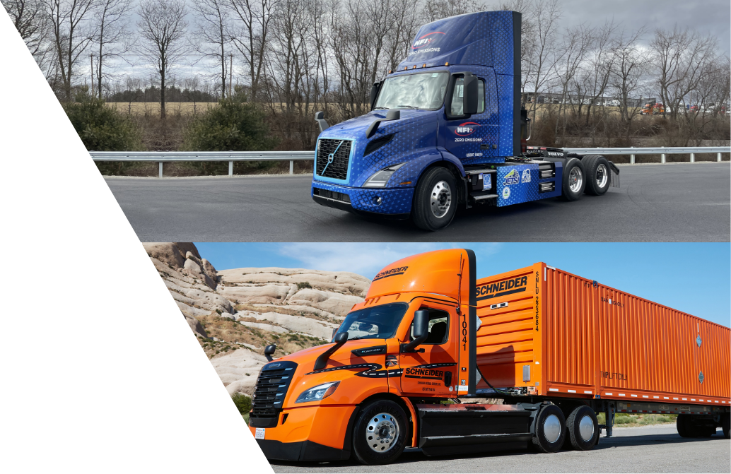
Deployment
Project partners Daimler Truck North America (DTNA) and Volvo Trucks North America (Volvo Trucks) are manufacturing and delivering the Class 8 battery-electric trucks (BETs) for deployment in the Southern California fleet operations of Schneider and NFI.
Operating in primarily in areas designated as air quality “disadvantaged communities,” the zero-emission trucks will replace the equivalent of over 690,000 diesel-gallons annually while accelerating commercialization of battery-electric trucks.

Slide 6
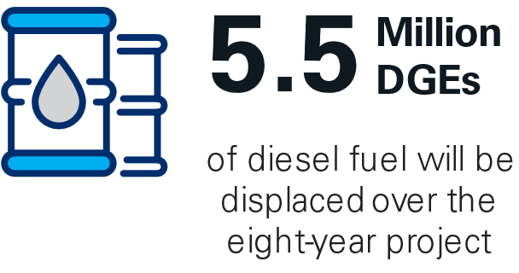
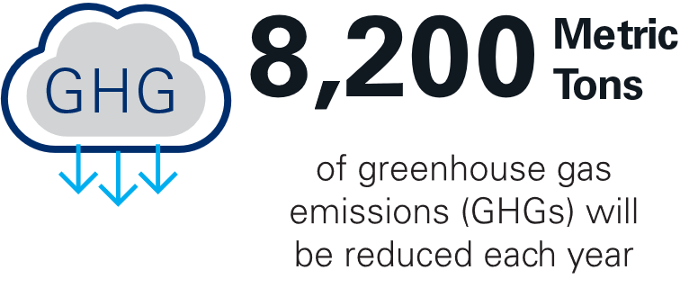
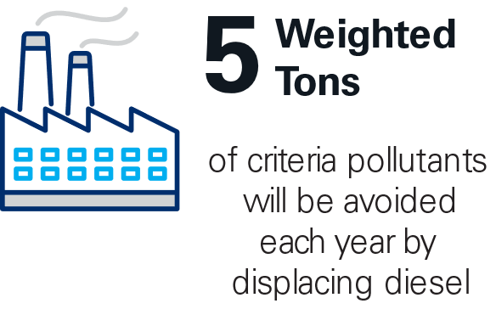
Project Focus
The project is poised to eliminate five tons of pollutants such as nitrogen oxides (NOx) and particulate matter (PM) annually along Southern California’s I-710 and other freight corridors, as well as eliminate 8,247 metric tons of greenhouse gas emissions.
Trucks will move freight across the region, including from the San Pedro Bay Port complex to inland distribution centers and warehouses, serving drayage and regional freight hauls.

Slide 7
Notes:
Here is a quick look at the routes the truck fleets will be traveling in the JETSI project in the greater Los Angeles region.
The blue and purple shaded areas show communities with a heavy pollution burden, and this will improve thanks to JETSI.

Slide 8
Timeline
The Battery electric trucks are being delivered to the two fleets during the first half of 2023, and project partners are hard at work on staff training, charging infrastructure, and the many other tasks required for the project.
Communities will increasingly start to see the new battery-electric trucks on our roads during 2023!

Slide 9
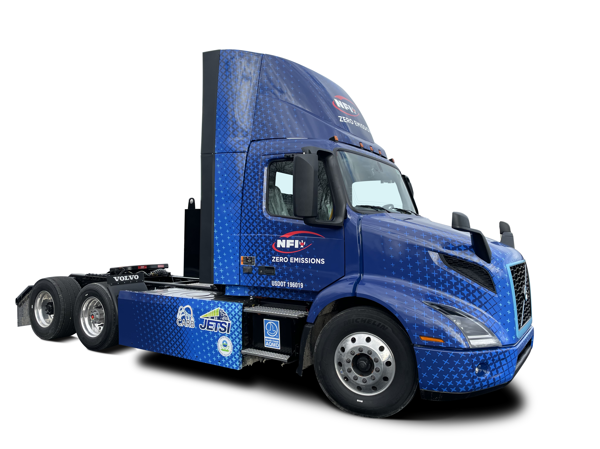
Joint Electric Truck Scaling Initiative
JETSI is led by South Coast AQMD and is the largest commercial deployment of battery-electric trucks in North America to date.
JETSI will significantly increase the number of zero-emission heavy-duty trucks doing goods movement and serves as a blueprint for zero-emission fleets across the nation and the world, with data analysis and public outreach to share findings.
 | NFI | Schneider
Duty Cycle | Drayage, regional haul | Drayage, Regional Haul
Number of trucks | 50 Class 8 BETs | 50 Class 8 BETs
Number of chargers | 19 350kW cabinets w/ 38 DC fast charger dispensers | 16 300+ KW chargers w/ 32 DC fast charger dispensers
Solar / Battery Storage | 1 MW / 5 MWh | -
Fleet Location | Ontario, CA | South El Monte, CA

Slide 10
Project Partners
Let us again thank the primary project funding partners below, and acknowledge JETSI is part of California Climate Investments, a statewide program that puts billions of cap-and-trade dollars to work reducing greenhouse gas emissions, strengthening the economy and improving public health and the environment – particularly in disadvantaged communities.

Slide 11
Learn More
Learn all the details of the project at the new JETSI website!
Gain knowledge on vehicles, charging infrastructure, workforce development, environmental benefits and more.
www.JETSIproject.com

